Slide 1
Jermyn Borough Council Meeting
04/17/2025

Slide 2

Meeting Agenda
April 17, 2025
CALL TO ORDER
PLEDGE OF ALLEGIANCE
ROLLS CALL
PREVIOUS MEETING MINUTES
TREASURER REPORT/BILLS PAYABLE
SECRETARY REPORT
CORRESPONDENCE
PUBLIC COMMENT
PROFESSIONAL REPORTS-POLICE, FIRE, SOLICITOR, ZONING, ENGINEER, TAX COLLECTOR, MAYOR
COMMITTEE REPORTS-SAFETY, PLANNING, FINANCE, SHADE TREE, REC, MS4, DPW
NEW BUSINESS

Slide 3
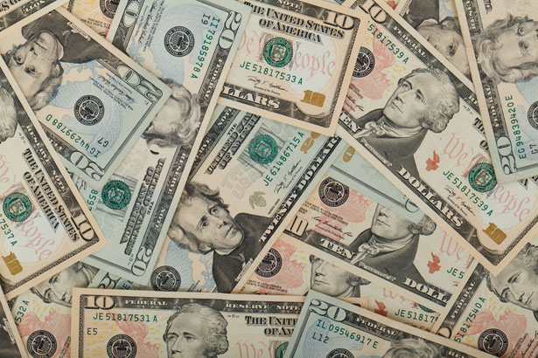
Treasurer’s report
4/17/2025
ASSETS
Checking/Savings
American Rescue Plan Fund 94,584.60
Capital Reserve - DPW 1,083.74
Capital Reserve - Police 6,439.82
Crime Watch Fund 222.69
General Fund - Community 66,842.30
General Fund - FNB 3,724.93
Holiday Lights Fund 400.59

Slide 4
Treasurer’s report
Investment - General Fund 1,133.21
Investment - Liquid Fuels 24,950.81
Investment - Paving Fund 1,145.00
Investment - Recycling 125.13
Investment - Refuse 178.44
Liquid Fuels - FNB 61,196.45
Petty Cash 194.00
Recreations Fund 29,984.56
Recycling - Community 6,396.07
Refuse Checking - FNB 101,771.73
Total Checking/Savings 400,374.07

Slide 5
Treasurer’s report
200000 · Accounts Payable 50,721.73
Long Term Debt 80,180.58

Slide 6
MS4 Minute
https://www.youtube.com/watch?v=sBhzpZD8i8s

Slide 7


